Slide 1
Azure Training Day Migrating .NET applications to Azure

Slide 2

Presentation title
Let’s get Started!
Tell us what you think by completing our survey
Schedule a post-event session to address your specific requirements.
Speaker name
Title
Learn more : aka.ms/techdocs
Get certified : aka.ms/microsoftlearn
Sign up Developer newsletter: aka.ms/usdevconnect

Slide 3
Azure Developer Series
Application Migration to Azure
Peter De Tender
@pdtit @007FFFLearning
Sept 2019
CEO & Lead Technical Trainer at 007FFFLearning.com

Slide 4
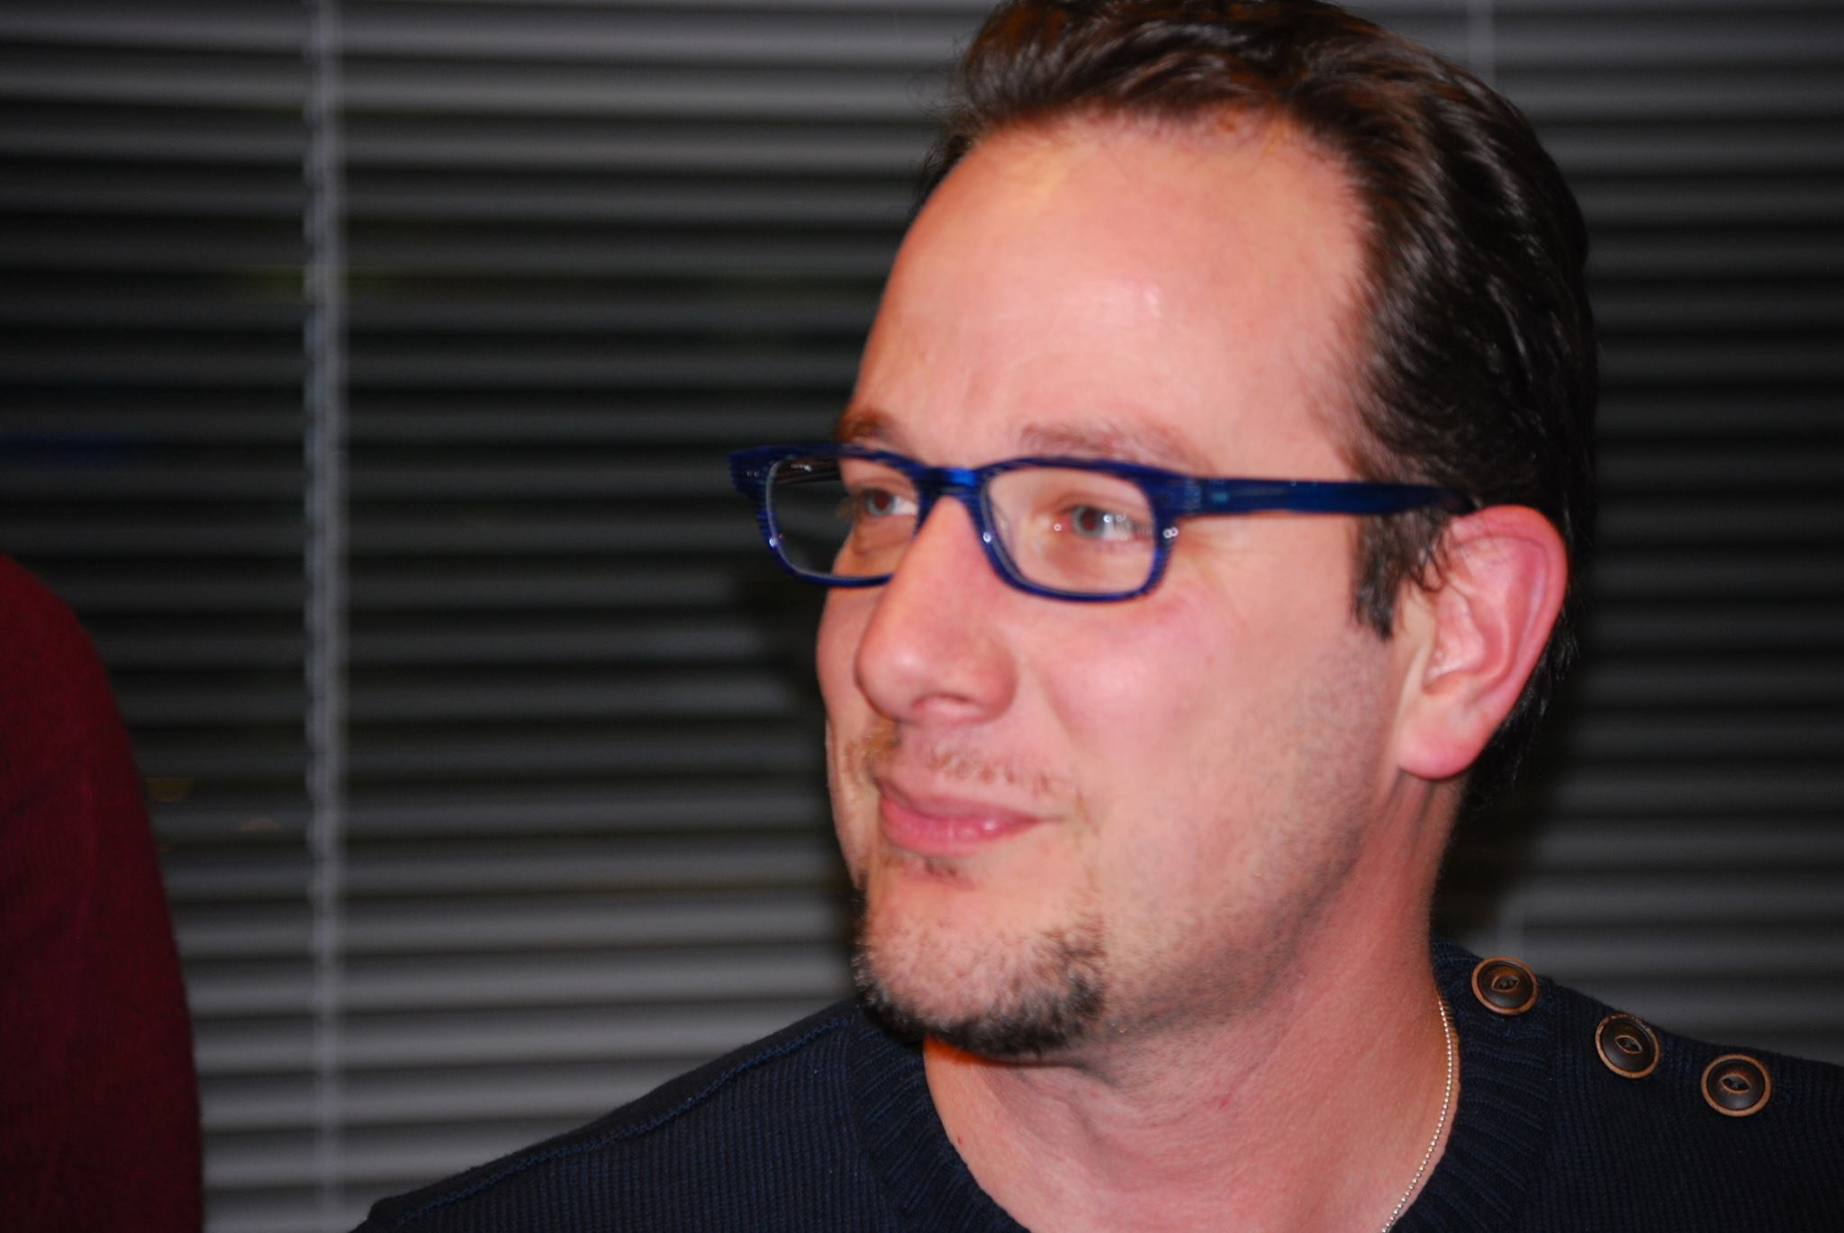
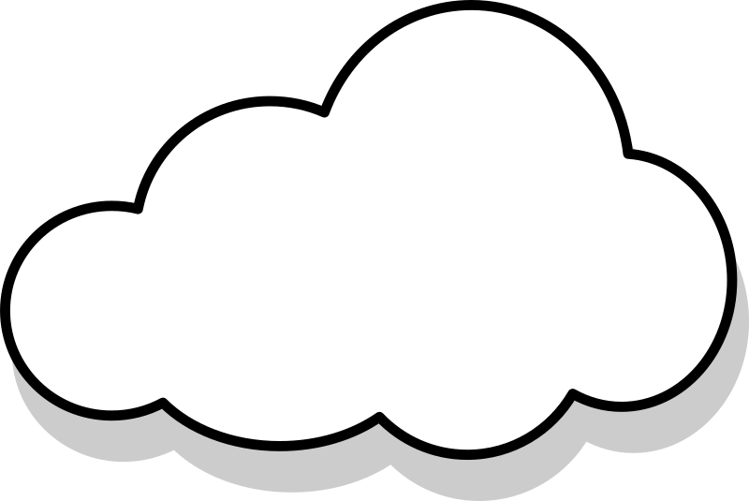
About Me…
Peter De Tender – MCT, Azure MVP
CEO and Lead Technical Trainer of 007FFFLearning.com, +20 years IT experience, mainly datacenters and Microsoft Infrastructure background
Full-time in Azure since 2013 (Readiness & Architect)
Azure Advisor, Azure Certified Architect
Technical Writer, Book author, Courseware Creator
Living in Belgium, but traveling worldwide 90% of my time, helping larger Microsoft Partners, customers and Microsoft FTEs in learning about and using Azure, by providing workshops with passion
peter@pdtit.be
@pdtit @007FFFLearning
http://www.facebook.com/pdtit
http://www.linkedin.com/in/pdtit

Slide 5
Workshop delivery
For the technical trainers:
Each Module could be presented as a stand-alone module, although the full potential comes from delivering all modules
HOL are somehow depending on each other, starting from the IAC-lab, where students deploy the VM-based source environment, moving to WebApps, SQL PaaS, Docker, Azure Container Registry, running Azure Container Instance, and ultimately Azure Container Services with Kubernetes. (only labs that could be skipped are WebApps and AKS)
The HOL solution is based on a ASP.NET Core app « SimplCommerce » (Open Source), using SQL Database

Slide 6
Workshop delivery
For the technical trainers:
Whenever you detect any mistakes, issues, wrong wordings,… in presentations or LAB guides, please send an email to :
msdevseriessupport@007FFFLearning.com, subject « Azure Developer Series – Containers », so we can take care of this and fixing it immediately
Latest version of all content should be available on GitHub:
http://www.github.com/007FFFLearning/MSDevSeriesSupport

Slide 7
Application Migration
Migrating an ASP.NET application to Azure using different Container services
Peter De Tender
@pdtit @007FFFLearning
Aug 2019

Slide 8
Setting the scene

Slide 9
Overview of the workshop
About the workshop content…
About: In this workshop, you will learn how to build a proof of concept (POC) that will transform an existing ASP.NET-based Web application (SimplCommerce) to a container-based application. This POC will deliver a multi-tiered web app solution from a Virtual Machine architecture into Azure, leveraging Azure WebApps and different Azure container solutions available today. You will also migrate the underlying database from a SQL Virtual Machine architecture to SQL Azure.
At the end of this workshop, you will have a good understanding of container concepts, Docker architecture and operations, Azure Container Services, Azure Kubernetes Services and SQL Azure PaaS solutioning.
Target Audience: The workshop is targeted to Cloud Architects, Cloud Solution designers, developers and IT sysadmins, CIO’s, CTO’s and anybody else who is interested in learning about Azure, containers, application cloud migration and digital transformation.
Focus of the workshop (40%) is getting hands-on experience, complemented with presentations and whiteboard sessions (if in-person delivery). Time Estimate: 16 hours (+/- 10 hours presentations, 6 hours of optional hands-on labs for attendees)

Slide 10
Workshop Agenda - Presentations
What we will talk about…
Module 1: Digital App Transformation with Azure
Module 2: Running Azure Infrastructure and execute Lift & Shift Migrations
Module 3: Performing proper assessments to smooth Azure Migrations
Module 4: Why and how migrating databases to Azure PaaS
Module 5: Migrating to Azure App Services – Azure Web Apps (.NET)
Module 6: Deploying Containers on Azure
Module 7: Deploying Azure Kubernetes Services
Module 8: Introduction to Azure DevOps
Module 9: Optimizing Azure Operations and Monitoring

Slide 11
Workshop Agenda – Hands On Labs
Learn by doing…
Module 2: Running Azure Infrastructure and execute Lift & Shift Migrations
Lab 1: Deploy an Azure VM Infrastructure using ARM-Templates
Module 3: Performing proper assessments to smooth Azure Migrations
Lab 2: Using Azure assessment tools
Module 4: Why and how migrating databases to Azure PaaS
Lab 3: Migrating SQL Databases to Azure using Database Migration Assistant
Module 5: Migrating to Azure App Services – Azure Web Apps (.NET)
Lab 4: Publishing application source code to Azure Web Apps using Visual Studio 2019

Slide 12
Workshop Agenda – Hands On Labs
Learn by doing…
Module 6: Deploying Containers on Azure
Lab 5: Containerizing applications using Docker and running it in Azure Container Instance and Azure WebApp for Containers
Module 7: Deploying Azure Kubernetes Services
Lab 6: Deploying Azure Kubernetes Services and running containerized apps from Azure Container Registry
Module 8: Introduction to Azure DevOps
Lab 7: Deploying Azure DevOps with CI/CD Pipelines and deploy your applications to Azure WebApps, WebApp for Containers, Azure Container Instance and Azure Kubernetes Services
Module 9: Optimizing Azure Operations and Monitoring
Lab 8: Monitoring and Managing your Azure deployed workloads

Slide 13
Technical Requirements
What you need…
<Could vary based on the actual delivery-method>, but overall:
Client workstation running recent Windows, Linux or Mac OS and latest internet browser
Access to ports 80 (HTTP), 443 (HTTPS) and 3389 (Remote Desktop)
Full Azure subscription (MSDN, AzurePass, Paid subscription, AE, CSP,…), where you have Owner permissions on subscription level
Lab consumption estimate: $15-35

Slide 14
Questions and HOL support
msdevseriessupport@007FFFLearning.com
Subject: Azure Developer Series – Containers
Response Time: within 4-8 hours
Check GitHub for FAQ and Updates: http://www.github.com/007FFFLearning/MSDevSeriesSupport

Slide 15
Questions
Landing
Spot
“…If you want good answers, ask better questions…”
© Randy Glasbergen

Slide 16
Digital Transformation
Why and How does Azure support digital transformation

Slide 17
Key Objectives
What you will learn in this section
Digital Transformation
The journey to the cloud
Introduction to Containers
Introduction to Microservices
Technologies covered in this workshop series

Slide 18
What is this digital transformation everybody talks about?
Digital Transformation
Digital transformation helps organizations to improve efficiency and effectiveness of service/products, using the latest available technology.
Instead of replicating an existing platform, we use technology to transform that service/product into something significantly better.

Slide 19
Digital Transformation
Digital Transformation is using technology to radically change the datacenter
Don’t focus on the location of the technology, but rather focus on the use of technology
Embrace the continuous flow of updates and changes, and keep up with it.
What is
digital transformation
for IT Admins?

Slide 20
Digital Transformation
Digital Transformation is using technology to radically change your application landscape
Don’t focus on dev language, but rather focus on the capabilities a language brings
Importantly, think broader than just the application,the data,… but how it runs and scales
What does
digital transformation mean
for Developers?

Slide 21



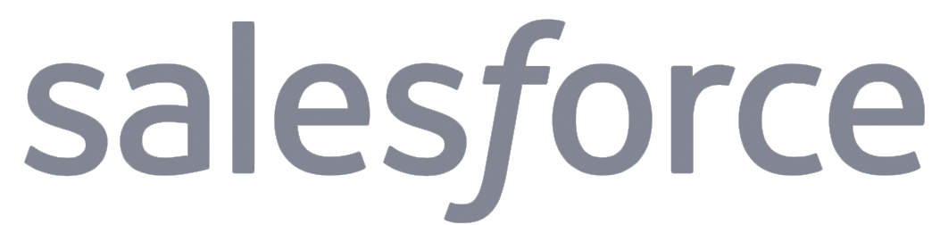
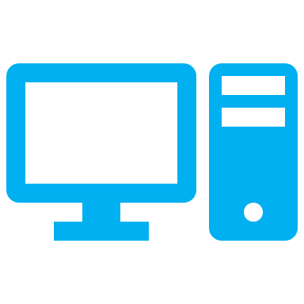


Digital Transformation is continuously evolving
Physical Datacenter
Mobility and SaaS
Virtualized Datacenter
BIG Data Solutions
Virtualized Datacenter in public cloud
Artificial Intelligence

Slide 22
What is App Modernization?
IT Simplification
Standardize on the platform and solutions
Migrate away from legacy systems
Integrate automation
GROWTH ENABLEMENT
Focus on the business growth, not the technology
Easily allow for business scale
Provide business Insights and Analytics
AGILITY
Faster deployment to different environments
Aligned deployment / Less mistakes
DevOps practices using continuous delivery
Reducing TCO
Downsize on infrastructure running cost
Minimize ongoing maintenance efforts
Make applications portable

Slide 23
What is the right size of
servers for my business needs?
How do I deploy new code to my server?
What media should I
use to keep backup?
What happens in case of
server hardware failure?
Which packages should be on my server?
What size of servers
should I buy?
Who monitors
my App?
How often should I backup my server?
How can I scale my app?
How can I increase server utilization?
Who has physical
access to my servers?
Which OS should I use?
Do I need secondary network connection?
Are my server in a
secure location?
What happens if the
power goes out?
Who monitors
my Servers?
Do I need a UPS?
What storage I need to use?
How many servers
do I need?
How can I dynamically configure my app?
It takes how long to provision a new server?
How often should
I patch my servers?
The “evolution” of application platforms
On-Premises

Slide 24
What is the right size of servers for my business needs?
How can I increase server utilization?
How many servers do I need?
How can I scale my app?
How often should I patch my servers?
How do I deploy new code to my server?
How often should I backup my server?
Which OS should I use?
Which packages should be on my server?
Who monitors my App?
The “evolution” of application platforms
On-Premises
IaaS

Slide 25
What is the right size of “servers” for my business needs?
How can I increase “server” utilization?
How many “servers” do I need?
How can I scale my app?
What are containers?
The “evolution” of application platforms
On-Premises
IaaS
PaaS

Slide 26
How do I (re)architect my app?
Serverless, the platform for next gen apps
The “evolution” of application platforms
On-Premises
IaaS
PaaS
Serverless

Slide 27
The journey to the cloud
Apps
Data & Intelligence
Migration & Modernization
Cloud-Native
SaaS
On-premises
Rehost
Refactor
Rearchitect
Rebuild/New
Replace
Infrastructure
DevOps
Deliver faster and more reliably

Slide 28
The journey to the cloud
SaaS apps
Serverless
Replace
Microservices
From on-premises systems to cloud applications
Containers
Rebuild or New
VMs
Rearchitect
Existing on-premises infrastructure and applications
Refactor
Rehost
App Modernization
Digital Transformation – started years ago already

Slide 29
The Cloud has become mainstream
In 2012: “if” we are moving to the cloud In 2017: “when” and “how” we are moving to the cloud
+200B
Y2020
$122.5B
Y2017
$60B
Y2015
$20B
Y2012
(*) Source: International Data Corporation - 2017

Slide 30
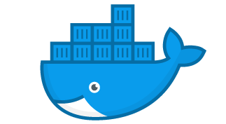
What are containers?
Virtual machines
Containers
Container
Container
Container
Container
App
App
App
App
App
App
App
Binaries & Libraries
Binaries & Libraries
Binaries & Libraries
Container
Container
Container
Container
Guest VM Operating System
Guest VM Operating System
Guest VM Operating System
App
App
App
App
Binaries & Libraries
Binaries & Libraries
Hypervisor
Docker Engine
Host Operating System
Host Operating System
Physical Server
Physical Server
Virtualize the hardware
VMs as units of scaling
Hypervisor dependent
Not easily movable
Virtualize the operating system
Applications as units of scaling
Platform independent
Easily movable across environments (on-premises, multi-cloud)

Slide 31

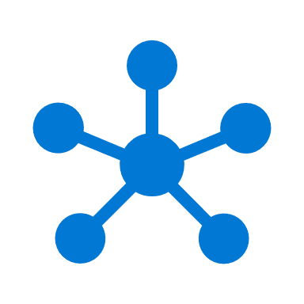

What are Microservices?
Monolithic
Microservices
Large, all-inclusive app
Small, independent services
From Monolithic to independent modules
App
App
App
Complex, larger, all-inclusive systems are rearchitected to simpler, smaller, single-purposed modules. Still resulting in a full-fletched application landscape
Each module runs a single functionality
These service modules are highly decoupled building blocks that are small enough to implement a single functionality but together can form larger systems
Independently versioned, deployed & scaled
With a microservices architecture, developers can create, manage and improve application services independently, even using different languages
Containers provide the consistent format and isolation desired by microservices.

Slide 32
How do containers help in app modernization?
Containers are stand-alone, smaller silos of app instances, running at scale
Container
Container
App
App
App
Binaries & Libraries
Container
Container
Guest VM Operating System
App
App
Existing/New Applications (=rehome)
Lift and shift to containers (= rehost, refactor)

Slide 33
How do containers help in app modernization?
Containers are not the end-state, but an in-between path to Microservices
Container
Container
App
App
App
Binaries & Libraries
Container
Container
Guest VM Operating System
App
App
Existing/New Applications (=rehome)
Lift and shift to containers (= rehost, refactor)
Microservices (=rearchitect)

Slide 34
Questions
Landing
Spot
“…If you want good answers, ask better questions…”
© Randy Glasbergen

Slide 35

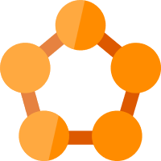




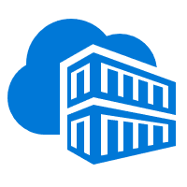
Running Containers on Azure: a full set of choices
App Service
Service Fabric
Kubernetes Service
Container Instance
Partner Ecosystem
Deploy web apps or APIs using containers in a PaaS environment
Modernize .NET applications to microservices using Windows Server containers
Elastically burst from your Azure Kubernetes Service (AKS) cluster
Bring your Partner solutions that run great on Azure
Scale and orchestrate Linux containers using Kubernetes
Azure Container Registry
Docker Hub
Choice of developer tools and clients

Slide 36
Containers on Azure: covered in this workshop
App Service
Kubernetes Service
Container Instance
Docker CE
Running Docker Containers as Azure Web Apps
Azure Container Services (ACS) with Kubernetes + Azure Kubernetes Service
Running Stand-Alone Docker Containers as a Container Instance
Docker Community Edition on Windows Server 2016/2019
Azure Container Registry
Docker Hub
Choice of developer tools and clients

Slide 37
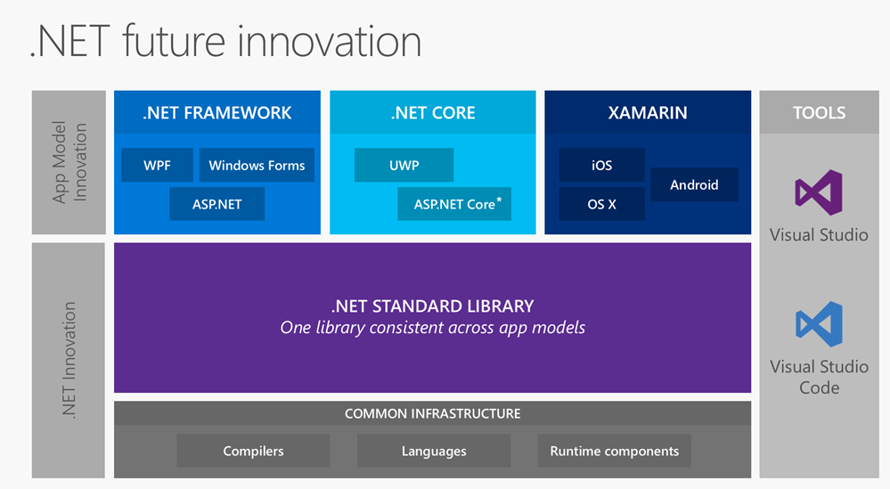
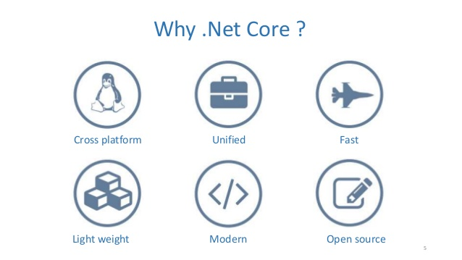
Isn’t a dotnet app the « easy » example?
.NET is used for 60% of all global Enterprise Web applications
Containers are not development language specific
Remember, digital transformation is focusing on the evolution, not the technology or language behind it
Examples we use in this workshop are just examples

Slide 38
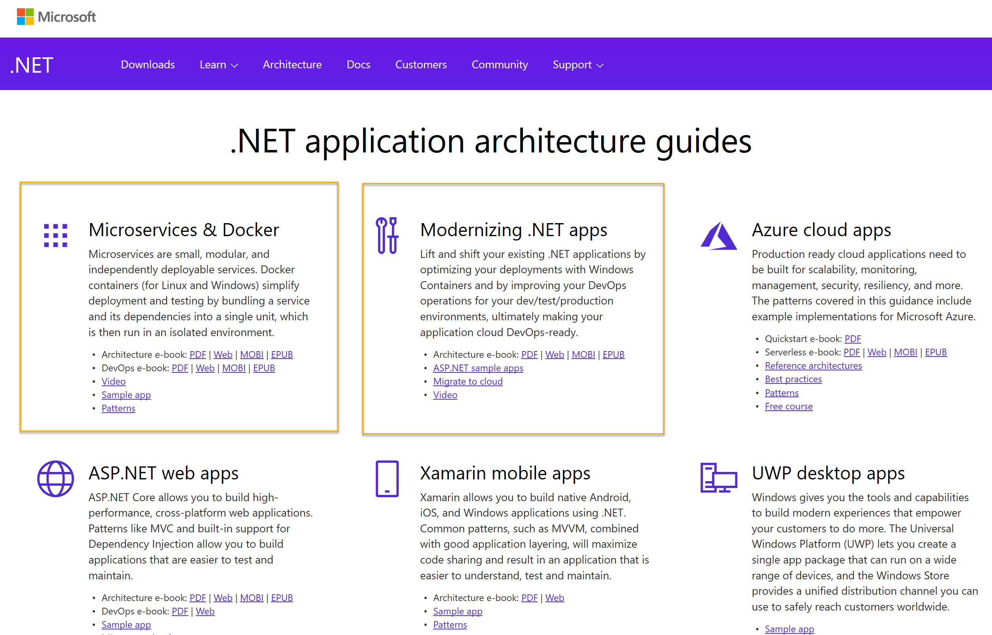
ASP.Net application architecture guides
https://www.microsoft.com/net/learn/dotnet/architecture-guides
Microservices
Docker
Windows Containers
Azure Containers

Slide 39
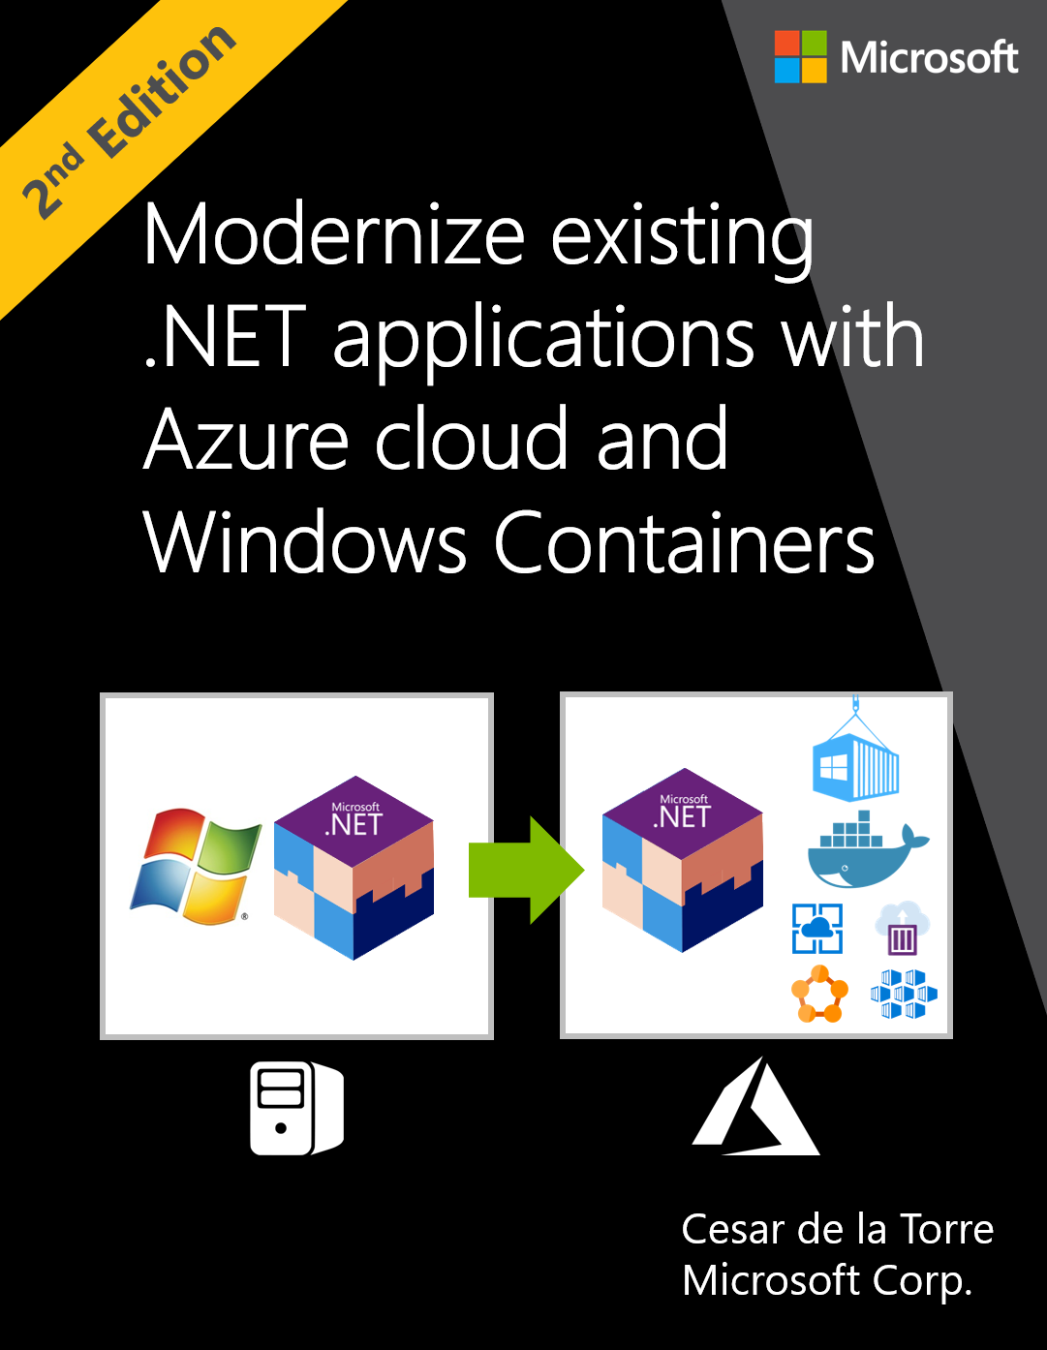
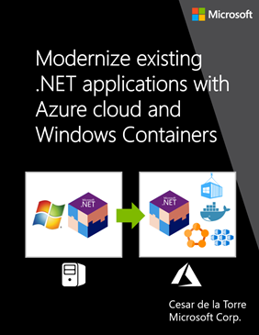
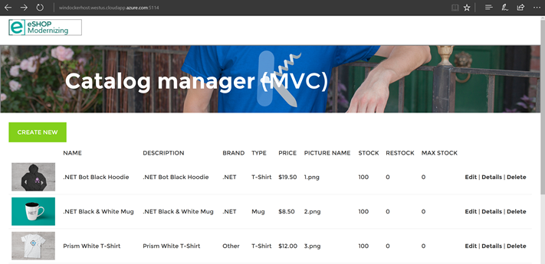
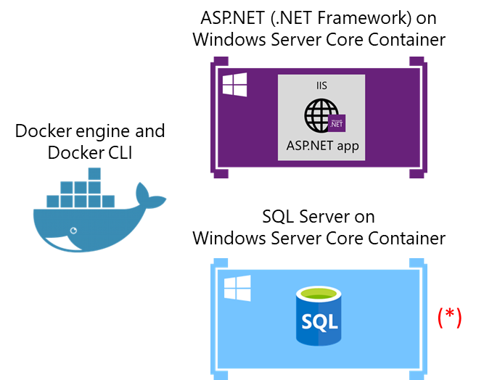
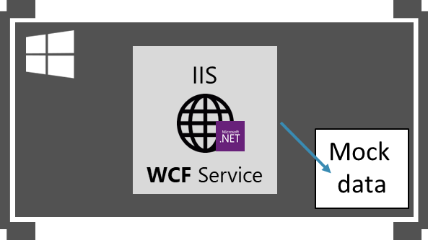
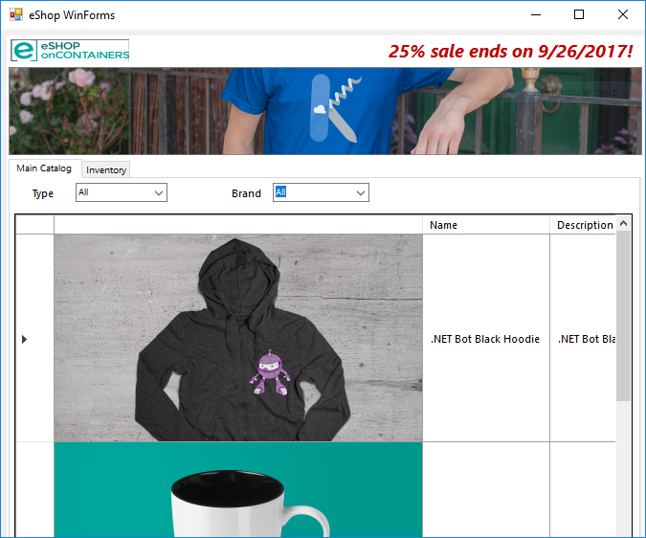
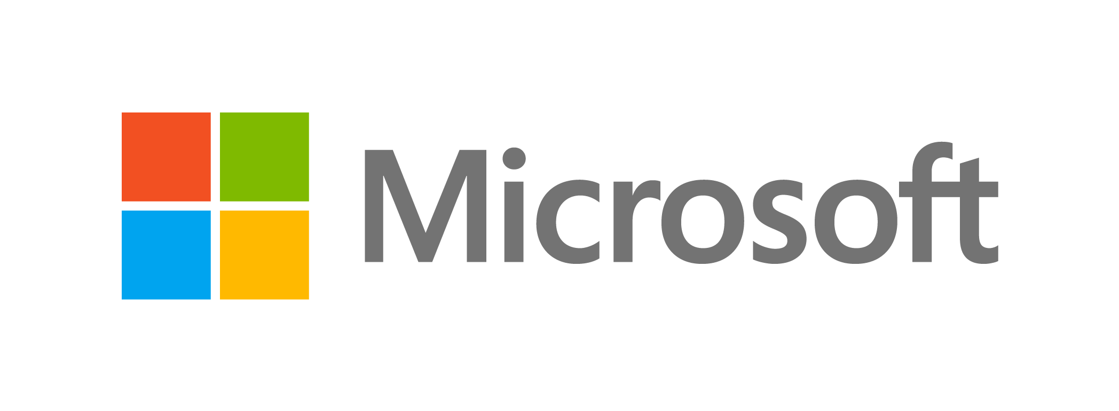
Guide/eBook and sample apps on Modernize with Windows Containers
eBook/Guide
Sample Apps for modernization
Intended for .NET developers and solution architects
Prescriptive guidance on how to modernize your existing .NET apps and migrate to the Azure cloud
Accompanied with journeys of modernizing existing ASP.NET web apps (WebForms, MVC) and N-Tier apps (WCF + WinForms) on eShopModernizing repository.
Client UI apps
Architecture
Browser
WinForms
ASP.NET
MVC &
Web Forms
WCF service on
Windows Container
WinForms
https://aka.ms/liftandshiftwithcontainersebook
https://github.com/dotnet-architecture/eShopModernizing

Slide 40
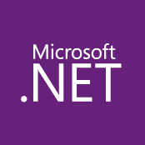
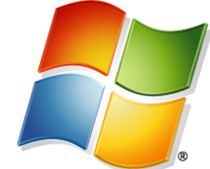
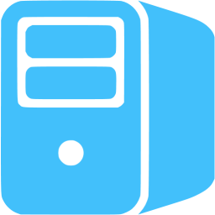
Maturity model for .Net applications
Existing apps
.NET web apps (on-premises)
Monolithic or N-Tier
architectures
Relational Database
On-premises
Architected for the cloud, needs new code

Slide 41
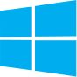
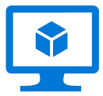
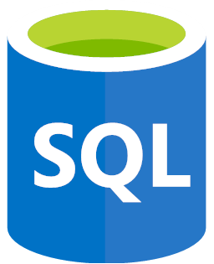
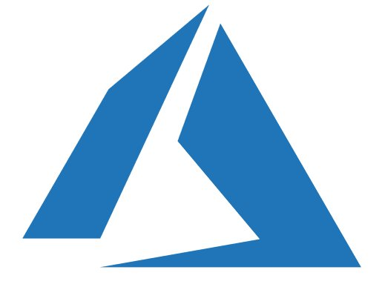
Maturity model for .Net applications
Existing apps
.NET web apps (on-premises)
Cloud
Infrastructure-Ready
Monolithic or N-Tier
architectures
Monolithic or N-Tier
architectures
Relational Database
IaaS
(Infrastructure as a Service)
VMs
On-premises
Azure
Base Cloud Environment and cross-cutting concerns: Network, Hybrid-cloud, Identity/Auth, Cost control and Operations model
Migrate / Rehost

Slide 42

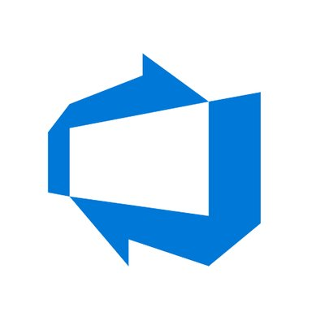
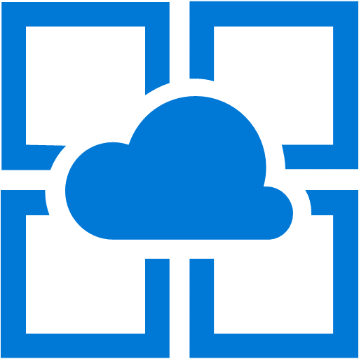
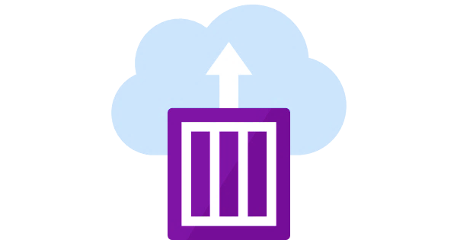
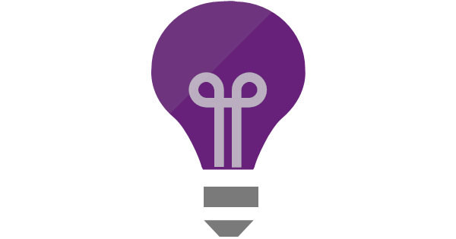
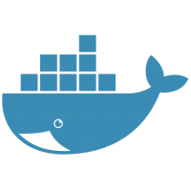
Maturity model for .Net applications
Existing apps
.NET web apps (on-premises)
Cloud
Infrastructure-Ready
Cloud-Optimized
PaaS
Monolithic or N-Tier
architectures
Monolithic or N-Tier
architectures
Monolithic or N-Tier
architectures
Relational Database
IaaS
(Infrastructure as a Service)
Managed services
VMs
And
Windows Containers
On-premises
Azure
Azure
Base Cloud Environment and cross-cutting concerns: Network, Hybrid-cloud, Identity/Auth, Cost control and Operations model
Migrate / Rehost
Modernize
Minimal code changes

Slide 43
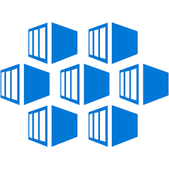
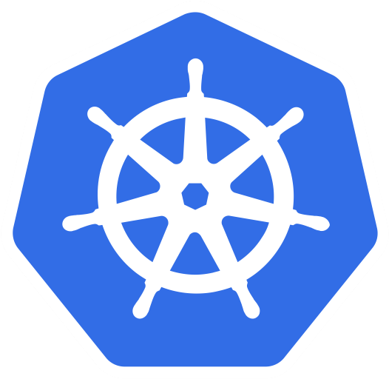
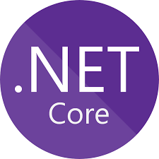
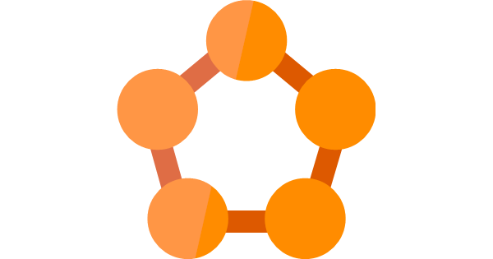
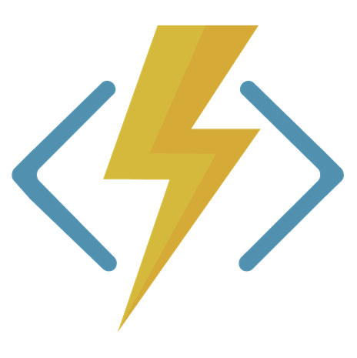

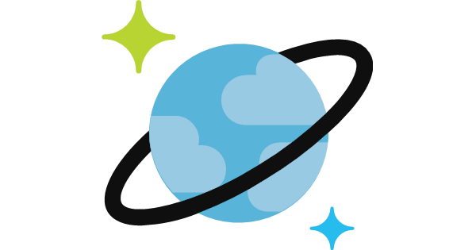
Maturity model for .Net applications
Existing apps
.NET web apps (on-premises)
Cloud
Infrastructure-Ready
Cloud-Optimized
PaaS
Cloud-Native
PaaS for microservices and serverless
Monolithic or N-Tier
architectures
Monolithic or N-Tier
architectures
Monolithic or N-Tier
architectures
Microservices and serverless architectures
Relational Database
IaaS
(Infrastructure as a Service)
Managed services
VMs
PaaS for containerized microservices
+ Serverless computing
+ Managed services
And
Windows Containers
On-premises
Azure
Azure
Azure
Base Cloud Environment and cross-cutting concerns: Network, Hybrid-cloud, Identity/Auth, Cost control and Operations model
Migrate / Rehost
Modernize
Minimal code changes
Architected for the cloud, needs new code

Slide 44
Maturity model for .Net applications
Migration to Web Apps / SQL PaaS
Cloud-Optimized
PaaS
Cloud-Native
PaaS for microservices and serverless
Existing apps
.NET web apps (on-premises)
Cloud
Infrastructure-Ready
Monolithic or N-Tier
architectures
Monolithic or N-Tier
architectures
Monolithic or N-Tier
architectures
Microservices and serverless architectures
Starting point for this workshop
IaaS
(Infrastructure as a Service)
Managed services
Relational Database
VMs
PaaS for containerized microservices
+ Serverless computing
+ Managed services
And
Windows Containers
Migration to Docker / Container Services
On-premises
Azure
Azure
Azure
Base Cloud Environment and cross-cutting concerns: Network, Hybrid-cloud, Identity/Auth, Cost control and Operations model
Migrate / Rehost
Modernize
Minimal code changes
Architected for the cloud, needs new code

Slide 45
Azure Compute Decision Tree for .Net Framework app migration
Azure App Service
ASP.NET
MVC app
Web Forms app
App has dependencies?
Azure Virtual Machines
NO
Web API Service
SignalR Service
YES
Web Pages app
Quick Migration Process?
Windows Containers on Azure VMs
WCF Service
YES
NO
Windows Containers on Azure Container Services (ACS)
Windows Containers on Azure Service Fabric
Dependencies can be documents, file system, COM-objects,… While containers support a quick migration path, since no code needs to be changed, it has a more complex learning curve than migration to Azure VMs

Slide 46
Section Take-Aways
Containers are a strategic way to modernize your existing .Net Framework applications
Azure provides different choices that enable app modernization
Azure natively provides several container services and orchestrators

Slide 47
Questions
Landing
Spot
“…If you want good answers, ask better questions…”
© Randy Glasbergen

Slide 48
Next Module…
Running Azure Infrastructure and performing VM Lift & Shift migrations
@pdtit @007FFFlearning

Slide 49
Thank You

